Slide 1

Department of Artificial Intelligence and Machine Learning
THIRD REVIEW
Adaptive ICU Patient Deterioration Prediction using Temporal Deep Learning and Explainable AI
TEAM MEMBERS
Kovendhan C (23619216)
Kanmani K U (23619213)
Mohamed Anas M (23619220)
INTERNAL GUIDE
Dr. G. Revathy, M.E., Ph.D.

Slide 2
Abstract:
Patient condition can get worse slowly in an intensive care unit, but it is not always easy to detect this early on. A machine learning system that analyzes patient records can provide an early indication that a patient may require closer monitoring. This paper presents an adaptive system for predicting patient deterioration in the ICU using time-series data from the eICU Collaborative Research Database. The system uses patient demographics, vital signs, laboratory results, treatment information, and other clinical observations. The data is cleaned, organized according to patient and time, and transformed into a suitable format for machine learning. Logistic Regression and Random Forest are used as baseline methods, while XGBoost is used as the main machine learning model. A GRU-based time-series model is also used for comparison. Predictions are generated for 6-hour, 12-hour, and 24-hour time horizons. The experimental results show that XGBoost achieved the highest ROC-AUC of 0.8740 for the 6-hour prediction horizon, followed by a ROC-AUC of 0.8390 for the 12-hour horizon. For the 24-hour horizon, the GRU model achieved with a ROC-AUC of 0.7214. These results demonstrate the ability of the proposed models to identify patterns associated with patient deterioration across different prediction horizons. Confusion matrices and ROC curves are used for further evaluation, while SHAP-based explainable AI is incorporated to identify the clinical factors contributing to the model predictions.
Keywords— ICU deterioration prediction, eICU Collaborative Research Database, temporal deep learning, GRU, XGBoost, explainable artificial intelligence, SHAP, clinical decision support.

Slide 3
Introduction
Intensive Care Unit (ICU) patients are at high risk of sudden health deterioration, requiring continuous monitoring.Early prediction of patient deterioration enables timely medical intervention and improves patient outcomes. This project develops an Adaptive ICU Patient Deterioration Prediction System using Temporal Deep Learning and Explainable AI (XAI).The system uses the eICU Collaborative Research Database, including patient demographics, vital signs, laboratory results, medications, and sequential clinical data. XGboost is used as the primary model to predict deterioration 6, 12, and 24 hours before it occurs, while SHAP explains the predictions. The system provides an interactive dashboard displaying risk level, confidence score, and key contributing factors, supporting better clinical decision-making.

Slide 4
LITERATURE SURVEY(BASE PAPER)
Authors: Manel Mili, Asma Kerkeni, Asma Ben Abdallah, Mohamed Hedi Bedoui
Title: ICU Mortality Prediction using Long Short-Term Memory Networks
Year: 2023
Methodology:
• Multivariate time-series clinical data
• Data preprocessing & missing-value handling
• 6-hour, 12-hour and 24-hour observation windows
• LSTM used for early mortality and Length of Stay prediction
Results:
• LSTM performed the other compared models for the 6-hour and 12-hour settings.
Limitations:
• Used the MIMIC-III dataset rather than a multi-center ICU dataset.
• Mainly focused on mortality and Length of Stay (LOS) prediction.

Slide 5
LITERATURE SURVEY
Authors:Jiaxing Wang, Xiaohui Zhao, Xiaolong Chen, et al.
Title:Development and Validation of a Dynamic Real-Time Risk Prediction Model for Intensive Care Unit Mortality Using Time-Aware Bi-Directional LSTM
Year:2025
Methodology:
• ICU time-series patient data
• Data preprocessing
• Time-Aware Bi-Directional LSTM
• Mortality prediction using temporal learning
Results:
• Improved ICU mortality prediction compared to traditional methods.
• Achieved ROC-AUC ≈ 0.90.
Limitations:
• Focused only on mortality prediction.
• Did not provide Explainable AI (XAI).
• No clinical dashboard for visualization.

Slide 6
LITERATURE SURVEY
Authors:Hany A. Aly, Mohamed A. Elhoseny, et al
Title:E-CatBoost: An Efficient Machine Learning Framework for Predicting ICU Mortality Using the eICU Collaborative Research Database
Year:2022
Methodology:
• eICU dataset
• Logistic Regression
• Random Forest
• CatBoost
Results:
• CatBoost achieved the best performance.
• Accuracy ≈ 89%.
• ROC-AUC ≈ 0.88.
Limitations:
• Used only machine learning models.
• Did not capture long-term temporal patterns.

Slide 7
LITERATURE SURVEY
Authors:Faisal Ahmed, Ahmed M. Kassem, et al.
Title:Early Prediction of Sepsis in Intensive Care Patients Using Machine Learning
Year:2023
Methodology:
• ICU patient data
• Feature engineering
• Random Forest
• XGBoost
• Early sepsis prediction
Results:
• Successfully identified sepsis at an early stage.
• ROC-AUC ≈ 0.86.
Limitations:
• Predicts only sepsis.
• Does not use deep learning.
• Limited explainability.

Slide 8
LITERATURE SURVEY
Authors:Rahul Vashisht, Benjamin Jung, et al.
Title:ICU Patient Deterioration Prediction: A Data Mining Approach
Year:2015
Methodology:
• ICU clinical data
• Data preprocessing
• Decision Tree
• Logistic Regression
• Random Forest
Results:
• Successfully predicted patient deterioration.
• Accuracy ≈ 85%.
Limitations:
• Used traditional machine learning only.
• Did not use temporal deep learning.
• No Explainable AI (XAI) or visualization dashboard.

Slide 9
Dataset Details
Dataset Name | eICU Collaborative Research Database
Source | PhysioNet
Hospital Type | Multi-center ICU data
Main Use | Critical-care research and predictive modeling
Time-Series Data | Vital signs, laboratory measurements, medications, and clinical observations
Our Prediction | ICU deterioration risk at 6h, 12h, and 24h
Dataset size | Rows: 138,953 Columns: 47 (pre-processed Dataset) Again pre-processed Dataset Rows:94,049 columns:47

Slide 10
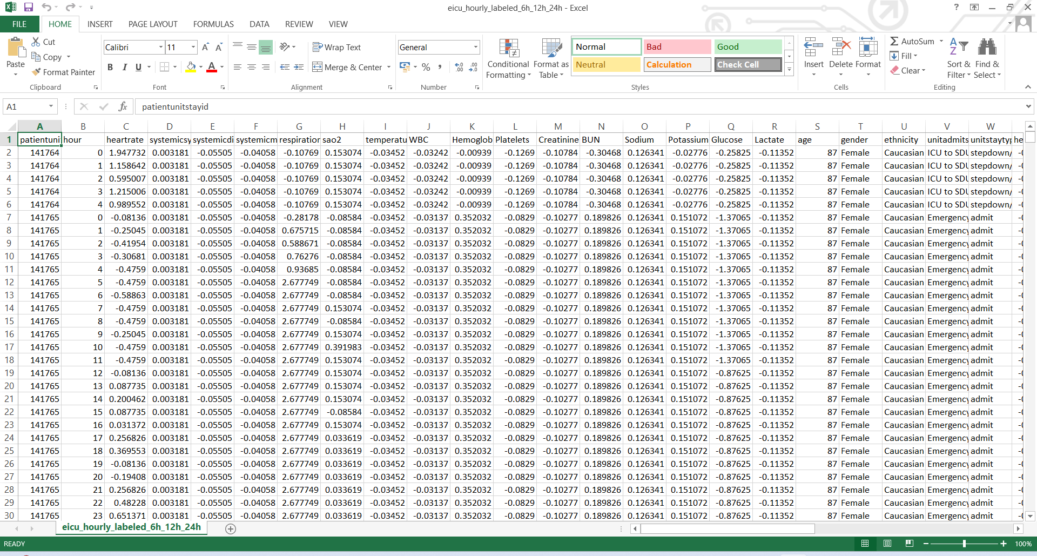
DATASET

Slide 11
Research Gap
Most existing studies focus on predicting patient mortality instead of early patient deterioration.
Many research works use either Machine Learning or Deep Learning, but only a few compare both approaches on the same dataset.
Existing models often provide predictions without explaining the reasons behind them, making them less transparent for clinicians.
Very few studies combine time-series deep learning, model comparison, Explainable AI (SHAP), and an interactive clinical dashboard into a single ICU early warning system.

Slide 12
Problem Statement
Phase 1:
Most hospital monitoring systems only display patient information and trigger alarms after a patient's condition worsens. They do not provide early predictions that help doctors take preventive action.
ICU patient data is often incomplete, noisy, and collected from multiple sources. This makes it difficult to build accurate prediction models without proper data pre-processing and feature selection.
Phase 2:
Many AI-based prediction systems only provide the final result without explaining why a patient is considered high risk. This makes it difficult for healthcare professionals to fully trust and use the predictions in clinical practice.
Doctors and nurses need a simple and easy-to-understand system that provides timely risk alerts. Existing solutions often lack a user-friendly interface for monitoring patient risk and supporting quick clinical decisions.

Slide 13
Objectives
Phase 1
Develop an AI-based Early Warning System to predict ICU patient deterioration.
Predict patient deterioration 6, 12, and 24 hours before it occurs.
Compare the performance of Machine Learning and Deep Learning models.
Phase 2:
Use SHAP Explainable AI to explain the factors influencing each prediction.
Build a user-friendly clinical dashboard to display patient risk levels and alerts.

Slide 14
Proposed System
The proposed system is an Adaptive ICU Patient Deterioration Prediction System that uses Machine Learning, Temporal Deep Learning, and Explainable AI to identify patients at risk of critical conditions early. ICU patient data, including vital signs, laboratory results, medications, and clinical observations from the eICU Database, are collected, cleaned, and transformed into time-series sequences to capture health changes over time. Machine Learning models such as Logistic Regression, Random Forest, and XGBoost are used as baseline models, while LSTM and GRU models are applied for temporal prediction. The best model is selected using evaluation metrics like Precision, Recall, F1-Score, ROC-AUC.SHAP is integrated to provide explainable predictions by identifying important clinical factors. The system includes a dashboard that displays patient risk levels, alerts, trends, and prediction insights to support early intervention and improved ICU management.

Slide 15
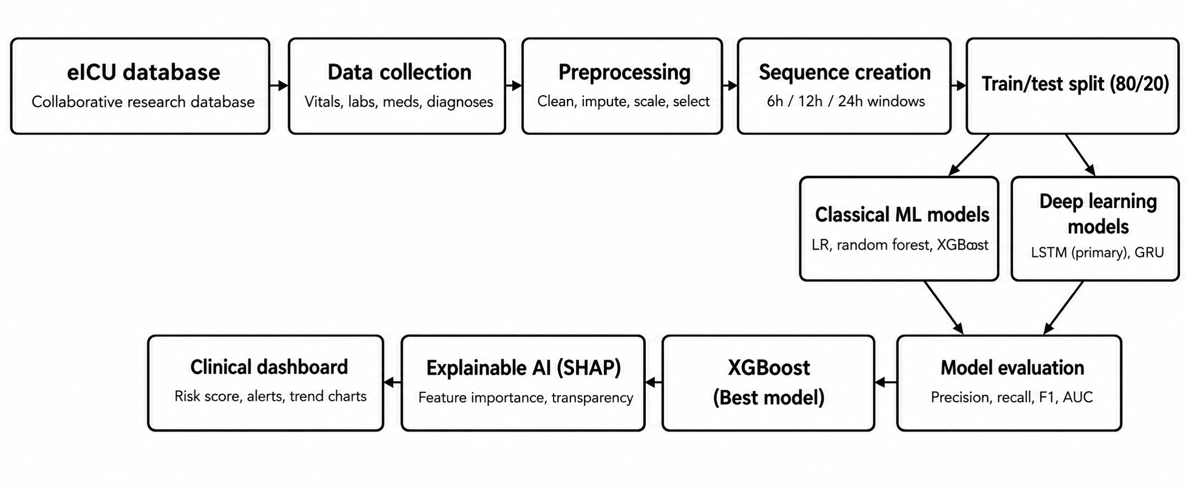
Architecture diagram

Slide 16
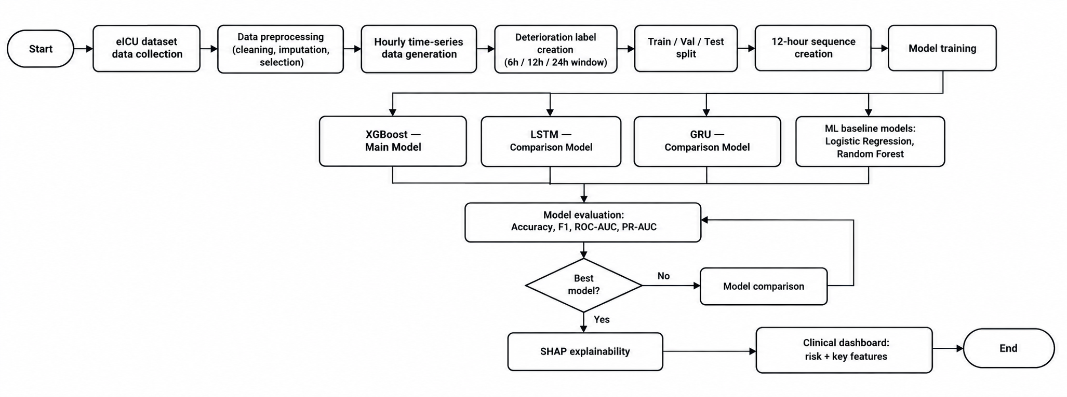
Flow chart

Slide 17
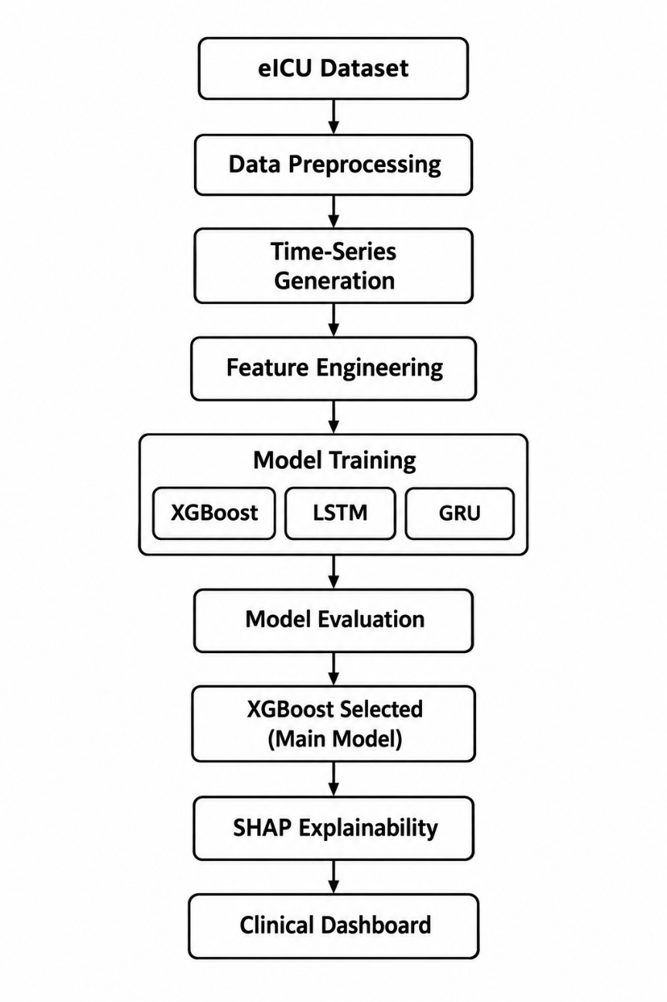
Flow Diagram

Slide 18
Software Requirements
• Operating System: Windows 10/11 or Linux
• Programming Language: Python 3.10+
• Development Environment: Jupyter Notebook / VS Code / Google Colab
• Data Processing: Pandas, NumPy
• Machine Learning: XGBoost
• Deep Learning: LSTM
• Explainable AI: SHAP
• Visualization: Matplotlib
• Dashboard: React/node.js
• Database: PostgreSQL

Slide 19
Hardware Requirements
• Processor: Intel Core i5 / AMD Ryzen 5 or above
• RAM: 8 GB minimum; 16 GB recommended
• Storage: 20–50 GB free space
• GPU: Optional; NVIDIA GPU recommended for faster LSTM/GRU training
• Internet: Required for dataset download and cloud tools

Slide 20
Module-Wise Implementation
Module | Implementation in Our Project
1. Data Collection | The eICU dataset is used as the primary data source. We collect patient vitals, laboratory results, demographic information and ICU stay details required for deterioration prediction.
2. Data Preprocessing | Raw ICU data is cleaned by handling missing values, duplicate records and abnormal values. Numerical clinical features are normalized before providing them to the deep-learning model.
3. Feature Engineering | Important clinical parameters such as Heart Rate, Blood Pressure, SpO₂, Respiratory Rate, Temperature and GCS are selected. Temporal/trend features are also generated to capture changes in patient condition.
4. Temporal Sequence Generation | Patient observations are arranged and converted into 24-hour time-series sequences. These sequences allow the model to learn how the patient's condition changes over time.

Slide 21
Module | Implementation in Our Project
5. XGboost Prediction | An XGboost model is trained using the 24-hour sequences. It learns temporal patterns in ICU observations and predicts the probability of patient deterioration.
6. Adaptive Risk Prediction | The model generates a patient-specific risk score and updates it when new time-series observations are available. Patients are categorized into Low, Moderate or High Risk.
7. Explainable AI (XAI) | SHAP is used to explain the model's prediction by identifying which clinical features contributed most to the predicted deterioration risk. Eg: Heart Rate = 145 (high) ⬆️ Pushed risk UP by +0.15 SpO2 = 88% (low) ⬆️ Pushed risk UP by +0.12
8. Evaluation & Visualization | Model performance is measured using Precision, Recall, F1-score and ROC-AUC. Risk trends and important clinical features are visualized for easier interpretation.

Slide 22
Challenges Faced
eICU dataset contains a large number of tables and clinical variables.
Different measurements have different time intervals.
Missing values are common in ICU data.
Creating consistent hourly time-series required preprocessing.
Deterioration events need careful definition.
ICU deterioration data can be highly imbalanced.
Preventing patient-level data leakage is important.

Slide 23
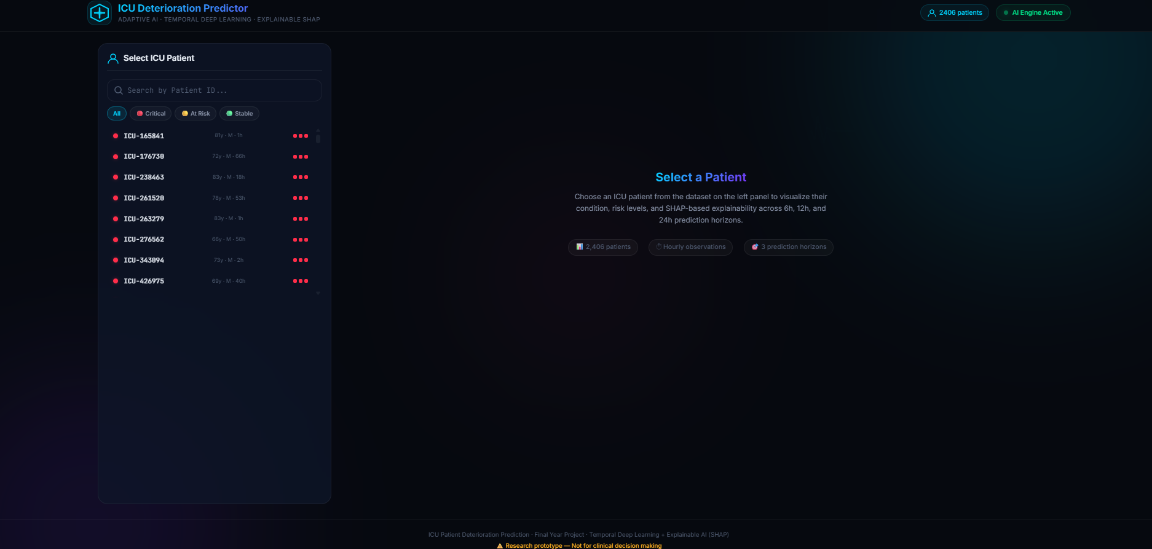
Implementation output

Slide 24
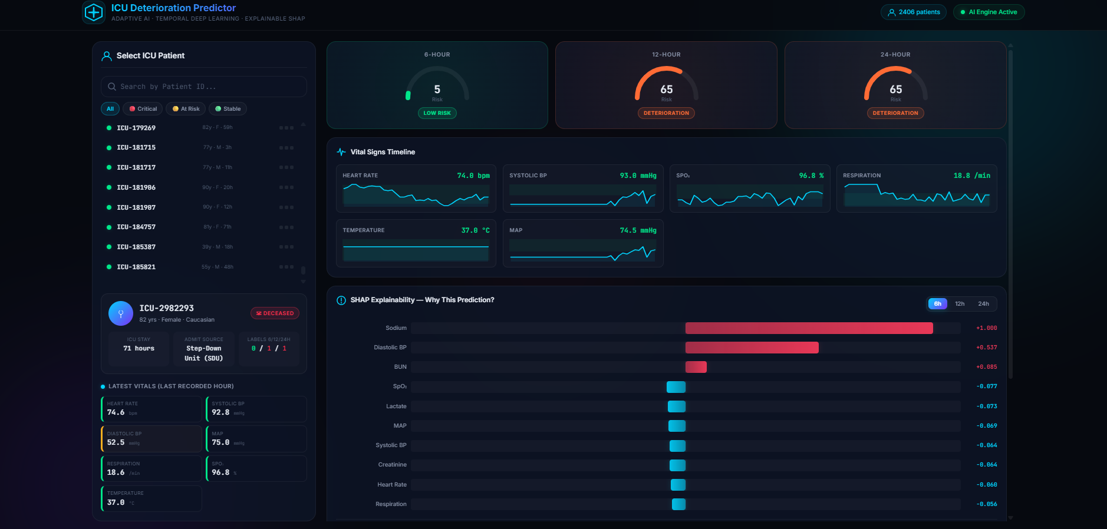
Implementation output

Slide 25
Result
The proposed system successfully processes ICU time-series data and predicts patient deterioration at an early stage using temporal deep learning and XGBoost.
 | Horizon | Model | F1 | Recall | ROC-AUC
0 | 12h | XGBoost | 0.0781 | 0.1754 | 0.8390
1 | 24h | GRU | 0.1366 | 0.1818 | 0.7214
2 | 6h | XGBoost | 0.0317 | 0.0741 | 0.8740

Slide 26
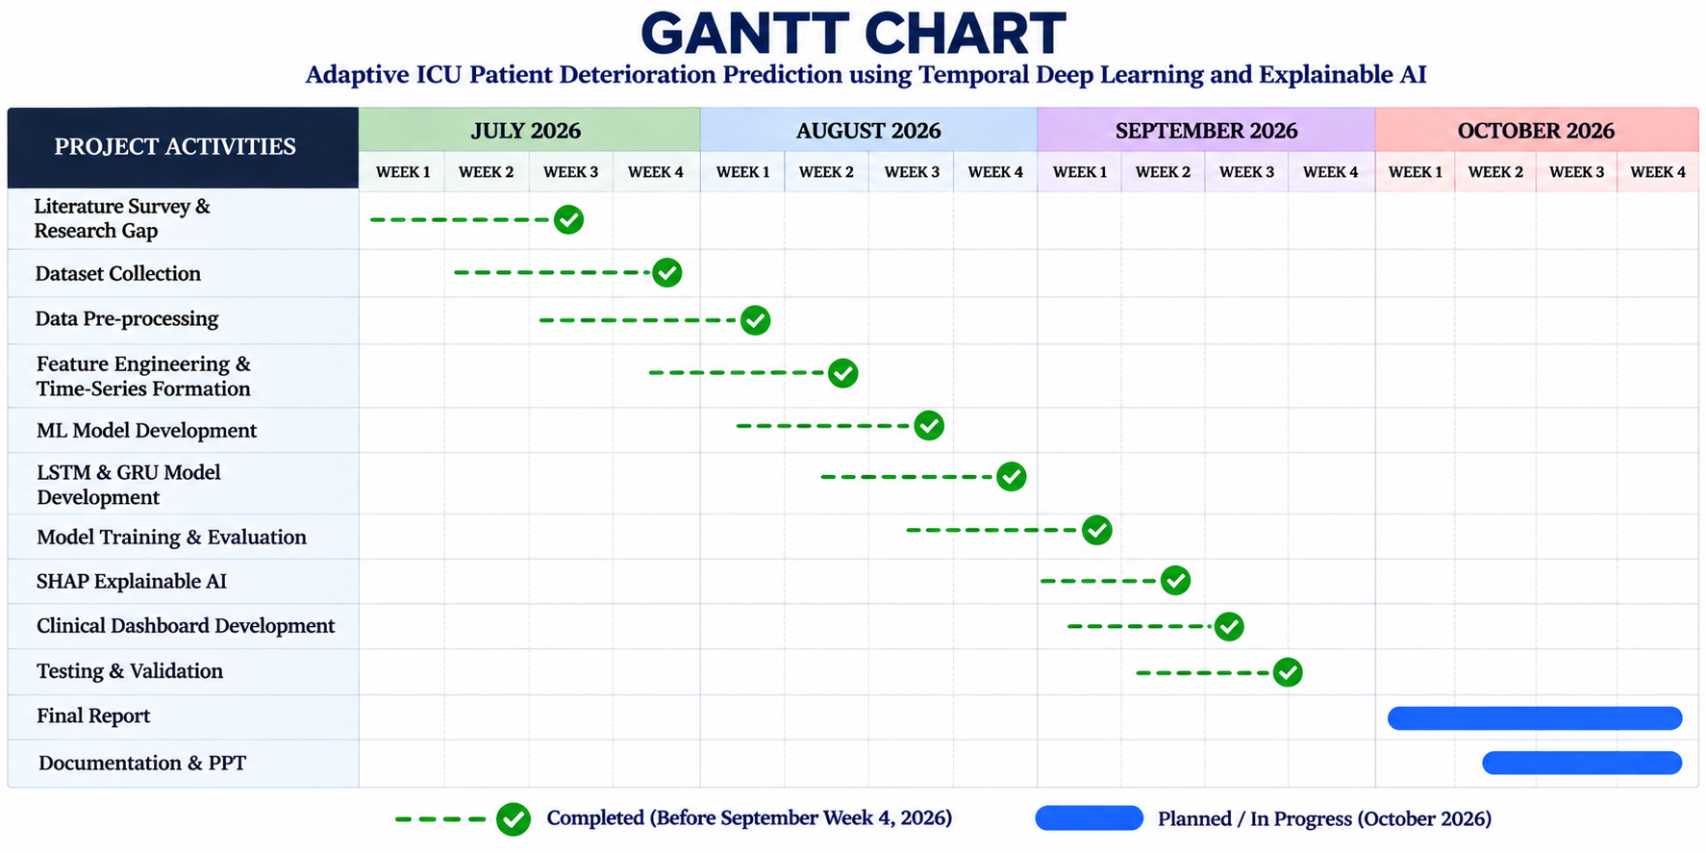

Slide 27
Conclusion
This project presents an intelligent early warning system for predicting ICU patient deterioration before critical events occur. By comparing Machine Learning models with Deep Learning models, the system identifies patients at high risk using sequential clinical data. SHAP is integrated to explain the model's predictions, making the results more transparent and reliable. The proposed framework aims to support healthcare professionals in making timely decisions and improving the quality of patient care.

Slide 28
References
M.Mili, A.Kerkeni, A.Ben Abdallah, and M.H.Bedoui, “ICU Mortality Prediction using Long Short-Term Memory Networks,” 2023.
J.Wang, X.Zhao, X.Chen, et al., “Development and Validation of a Dynamic Real-Time Risk Prediction Model for Intensive Care Unit Mortality Using Time-Aware Bidirectional LSTM,” 2025.
H.A.Aly, M.A.Elhoseny, et al., “E-CatBoost: An Efficient Machine Learning Framework for Predicting ICU Mortality Using the eICU Collaborative Research Database,” 2022.
F.Ahmed, A.M.Kassem, et al., “Early Prediction of Sepsis in Intensive Care Patients Using Machine Learning,” 2023.
R.Vashisht, B.Jung, et al., “ICU Patient Deterioration Prediction: A Data Mining Approach,” 2015.

